Slide 1




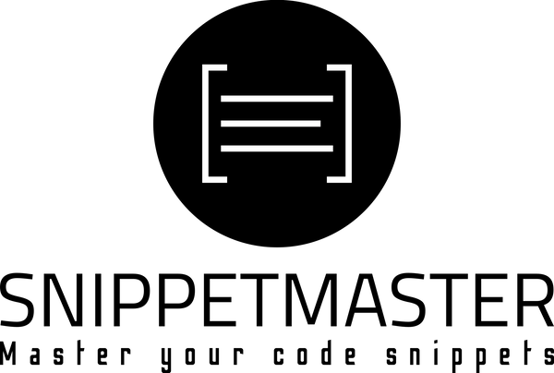

Elevating React Development
Ensuring Code Quality and Security with SonarQube

Slide 2

My React Journey
Ever since I started using React, I have been amazed by its capabilities and it has become my favourite Library.
My Experience with Sonarqube
I started using SonarQube for my React projects last year and it has been an absolute game-changer for ensuring code quality and security.
ABOUT ME

Slide 3
Let’s Begin...
“Any fool can write code that a computer can understand. Good programmers write code that humans can understand”
- Martin Fowler
ELEVATING REACT DEVELOPMENT WITH SONARQUBE

Slide 4
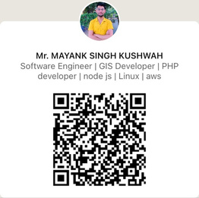

Maintaining Code Quality
Manual Code Reviews
Component Reusability
Security Vulnerabilities
Problem
Statements
Code is maintained more often than it is written

Slide 5

SonarQube (formerly known as SonarSource).
SonarQube is an automatic code review tool that detects bugs, vulnerabilities, code duplication, code smells, test coverage, and excess complexity in a project.
It has support for 27 different programming languages.
SonarQube

Slide 6
Sonar defines coding issues in the below categories
Bug (Cause unexpected problems)
Code Smell (Violations of code design)
Vulnerability (Weakness of security)
New Security Hotspot (Security-sensitive piece of code)
Each above categories can be further classified based on severity as below,
Blocker
Critical
Major
Minor
Info
SonarQube

Slide 7
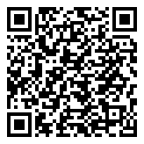
Write Clean Code
Overall Health
Enforce Quality gate
Analyze Pull requests
Dig into Issues
Detect Bugs for Better Code Quality
Detect Bugs
Code Smells
Security Vulnerability
Multi-Language Supports
Centralize Quality
All projects in one place
Shared rulesets
It helps for different users in Organization
Developers
Technical management
Non-technical management
Main Features

Slide 8

SonarLint is a free, open-source IDE extension that helps users identify and fix coding issues during the writing codes.
SonarLint works like a spell checker, Unreachable source code, highlighting issues as you type.
It provides clear remediation guidance so you can fix issues before committing code.
SonarLint is like having a coding buddy that helps you become a better programmer. As you write code, it's like having a teacher right there with you, pointing out ways to improve.
SonarLint
CLICK ME TO DOWNLOAD SONARLINT

Slide 9


Q&A ?

Slide 10
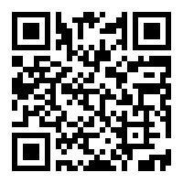
I’d love your feedback on my session!
Thankyou

